Slide 1
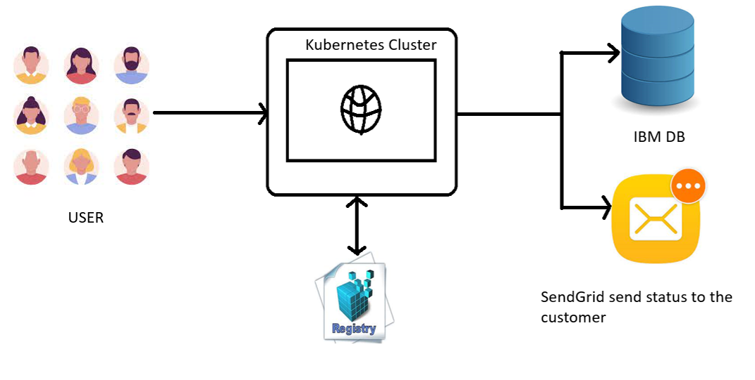
TRCHNICAL ARCHITECTURE:

